Slide 1

Contrastive Multiple Correspondence Analysis (cMCA): Applying the Contrastive Learning Method to Identify Political Subgroups
Mario Palomino Viero
Sandaru Welikala
Rachel Mendosa
Komalpreet

Slide 2
OBJECTIVE
The objective of this study is to replicate the analysis performed in the original study on Contrastive Multiple Correspondence Analysis (cMCA) by exclusively applying a set of dimensional reduction and classification techniques namely Ordered Optimal Classification (OOC), Multiple Correspondence Analysis (MCA), Basic Space (BS), Bayesian Mixed Factor Analysis (BMFA), and Contrastive Multiple Correspondence Analysis (cMCA) specifically to the Cooperative Congressional Election Study (CCES) 2015 dataset.

Slide 3
DATA
Key features of the dataset include:
Demographics: Information on respondents' age, gender, race, education, and income.
Political Behavior: Voting patterns, party identification, and political ideology.
Policy Opinions: Views on various policy issues such as healthcare, taxation, and climate change.
Geography: Location data at different levels (state, district, etc.).
Survey Design Variables: Weights and other variables to adjust for sample representation.
Cooperative Congressional Election Study (CCES)
The raw dataset comprises 253 features (survey questions) and 14,248 responses, containing both numerical and categorical data.
Issuevalue_short – Dataset of this study
The issuevalue dataset contains 1000 records and 53 columns. It is a cleaned and processed version of survey responses from the CCES15_Common_OUTPUT_Jan2016.tab raw data file.

Slide 4
TECHNIQUES
Advanced Techniques for Analyzing and Classifying Complex Categorical and Mixed Type Data
Ordered Optimal Classification (OOC).
Multiple Correspondence Analysis (MCA).
Basic-Space Procedure (BS).
Bayesian Mixed Factor Analysis (BMFA)
Contrastive Multiple Correspondence analysis (cMCA).

Slide 5
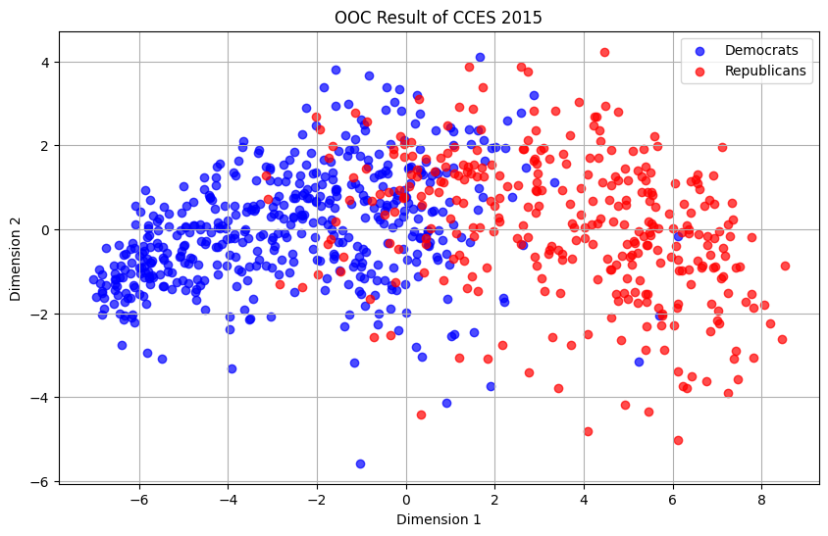
Ordered Optimal Classification (OOC)
Ordered Optimal Classification (OOC) is a method for identifying ideological structures and polarization in ordered categorical data.
The result of OOC visualization reveals a clear ideological separation between the two groups, with Democrats clustering on the left side and Republicans on the right, indicating potential polarization along these dimensions.

Slide 6
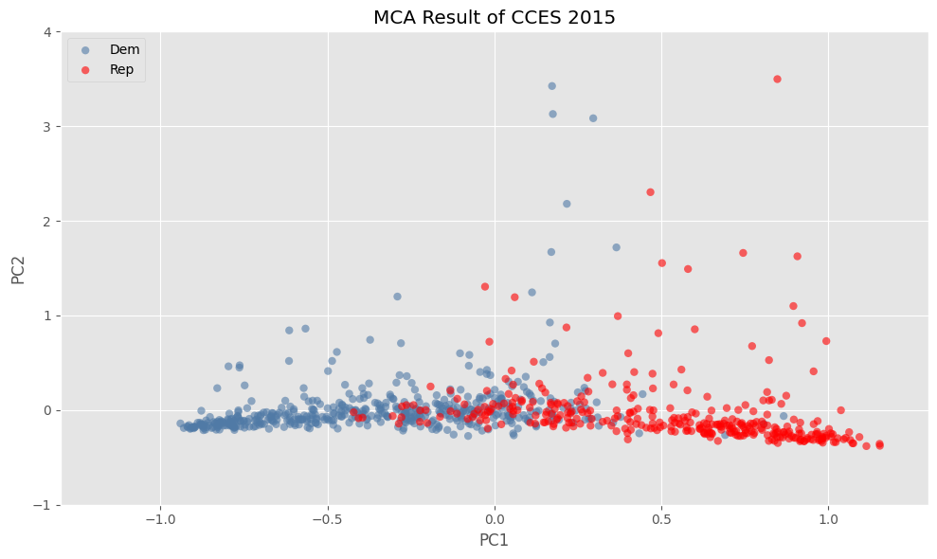
Multiple Correspondence Analysis (MCA)
Multiple Correspondence Analysis (MCA) is a dimensionality reduction technique for visualizing relationships between categorical variables.
The MCA visualization illustrates the distribution of different party affiliations across the reduced dimensions, highlighting ideological patterns and potential polarization. The result shows some overlap and distinct clusters.

Slide 7
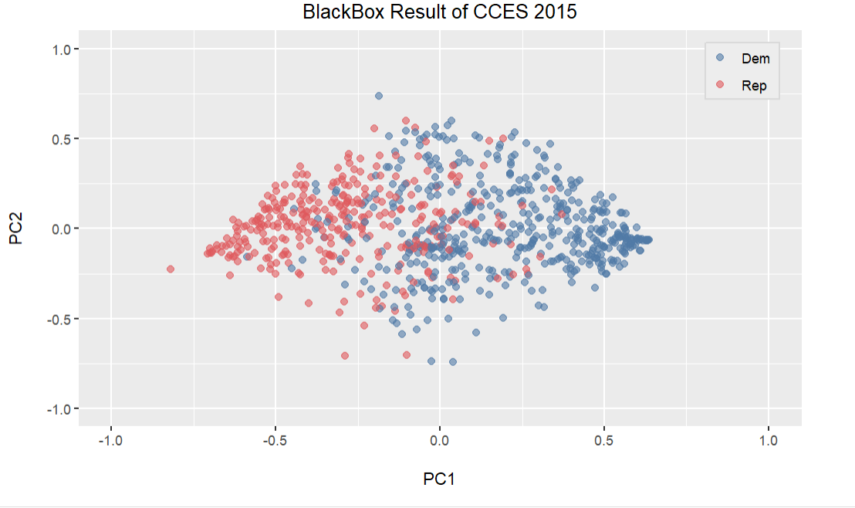
Basic-Space Procedure (BS)
The Basic-Space (BS) procedure is a method for uncovering latent ideological dimensions by mapping political preferences in a lower-dimensional space.
The BS procedure visualization highlights the ideological structures within the dataset, showing potential polarization, with the overlap and separation of colors indicating the degree of ideological alignment and division between the party groups.

Slide 8
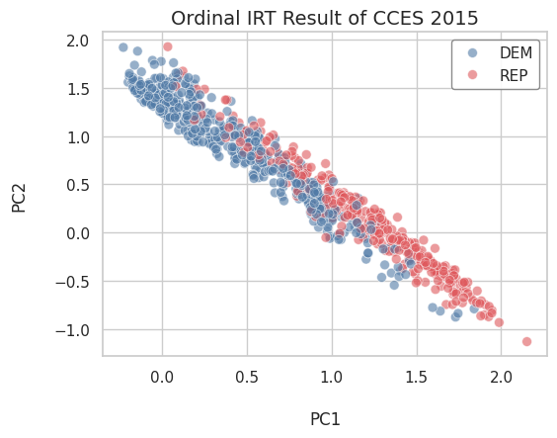
Bayesian Mixed Factor Analysis (BMFA)
Bayesian Mixed Factor Analysis (BMFA) is a probabilistic method for uncovering latent dimensions in datasets with mixed continuous and categorical variables.
The scatter plot shows an ideological gradient along the first principal component (PC1), with Democrats (blue) and Republicans (red) forming distinct clusters. While there is some overlap, the overall trend indicates polarization, reinforcing patterns of ideological positions within the dataset.

Slide 9
Prior cMCA
The four methods for dimensional reduction and estimation reveal a consistent pattern among American voters, highlighting a clear separation between Democrats and Republicans on the first principal component or left-right scale, based on self-reported values.
This suggests that voters' preferences, closely tied to party affiliation and vote choices, show significant ideological polarization. This aligns with earlier research. (Fujiwara and Liu 2020) Additionally, we are going to use cMCA to assess its effectiveness in distinguishing subgroups, where traditional methods also perform well.
Contrastive learning (CL) is an emerging machine learning approach, which analyzes high dimensional data to capture patterns that are specific to, or enriched in, one dataset relative to another (Abid et al. 2018).
The logic behind CL is to explore unique components or directions that contain more salient latent patterns in one dataset (the target group) than the other (background group). (Fujiwara and Liu 2020)

Slide 10
cMCA Definition
Contrastive Multiple Correspondence Analysis (cMCA) is a method for analyzing data that uses contrastive learning to identify groups within data. It can be used to analyze data that contains binary, ordinal, and nominal variables by :
Split the data into groups
Select a group as the target and compare it to a background group
Find the principal components (PCs) where the target group's ideal points vary the most, while the background group's ideal points vary the least
cMCA can help identify important dimensions and divisions within groups that might be missed by traditional methods. It can also help derive latent traits that emphasize subgroups that are only moderately seen in traditional methods.

Slide 11
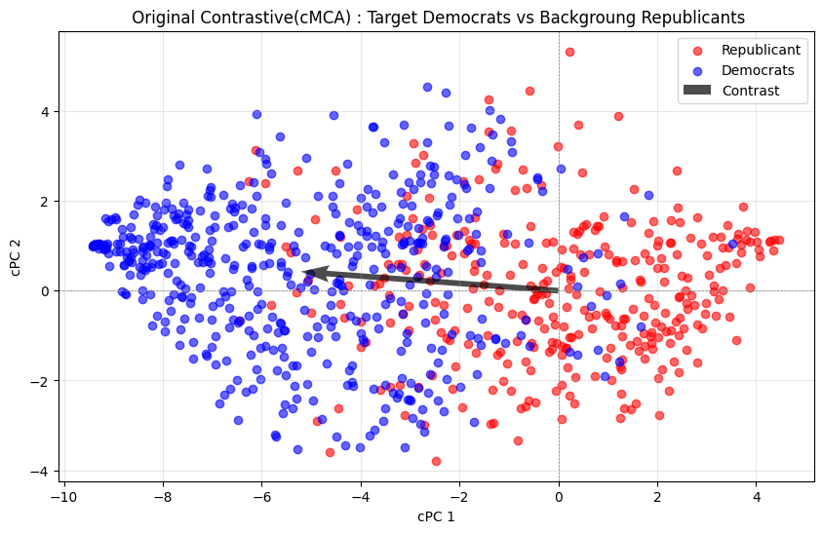
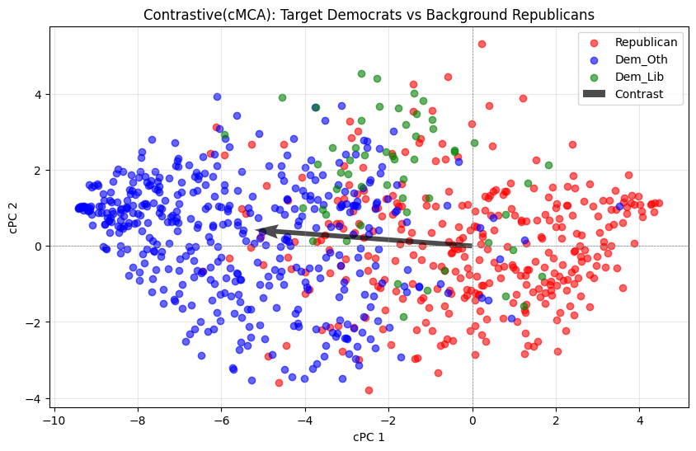
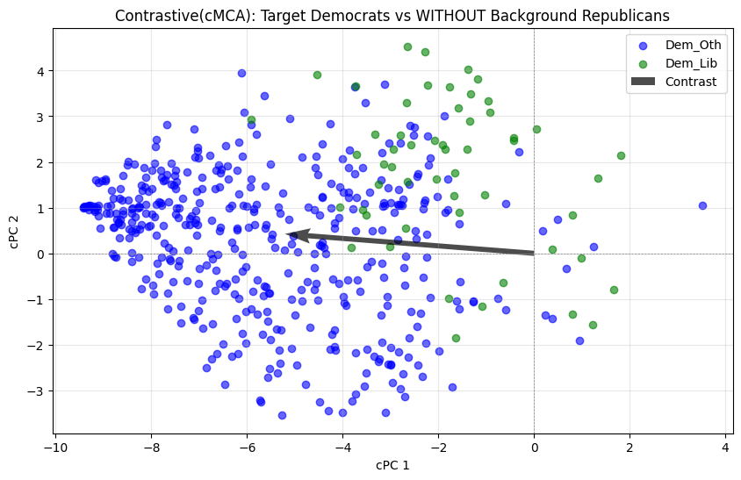
Contrastive MCA of Democrats with some Republican Affinity
(a) Target: Dem, Background: Rep (Original cMCA Results)
(b) Target: Dem, Background: Rep (with Background Rep)
(c) Target: Dem, Background: Rep
(without Background)
The paper divides Democrats into Democrats Orthodox(Dem_Oth) and Democrats Liberals (Dem_Lib) based on Dem_Lib alignment with Republican ideas military-diplomacy priority, military strength, and unequal rights not a big problem. As mentioned by (Fujiwara and Liu 2020).
With the cMCA allows to identify an overlap between democrats and republicans. Also, the subgroup of Dem_Lib and Dem_Oth separation.

Slide 12
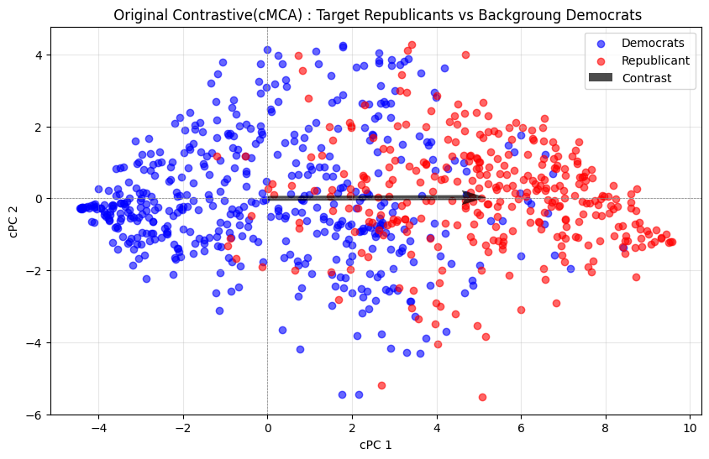
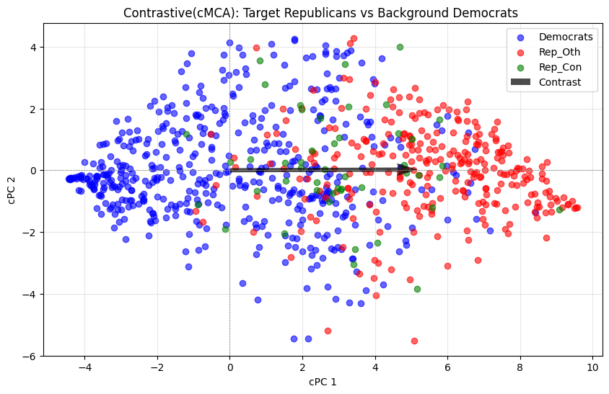
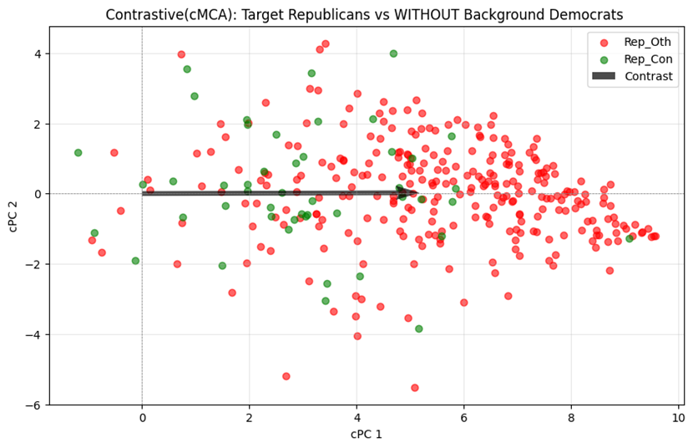
Contrastive MCA of Republicans with some Democrat Affinity
(d) Target: Rep, Background: Dem (Original cMCA Results
(e) Target: Rep, Background: Dem (with Background)
(f) Target: Rep, Background: Dem (without Background)
The paper divides Republicans into Republicans Orthodox(Rep_Oth) and Republican Conservatives (Rep_Con) based on Rep_Con alignment with Democrats ideas social ideology, economic ideology, and national security ideology. As mentioned by (Fujiwara and Liu 2020).
With the cMCA allows to identify an overlap between republicans and democrats. Also, the subgroup of Rep_Con and Rep_Oth separation.

Slide 13
Discussion
The original research paper discusses how typical PC methods often fail to provide informative results due to the inherent structure of different datasets. In contrast, cMCA enables researchers to derive contrasted dimensions from categorical data.
Our findings are consistent with this, as cMCA successfully identified substantively important dimensions and divisions that offer complementary information even when traditional PC analysis finds meaningful low-dimensional spaces. For instance, in situations where conventional methods revealed overlapping ideological distributions, cMCA was able to pinpoint specific divisions, such as differences in policy priorities between progressive and moderate Democrats.
Ultimately, our use of cMCA underscores its utility as a powerful tool for uncovering hidden patterns and ideological divergences within political data, advancing our ability to understand and interpret complex political landscapes.

Slide 14

Q & A

Slide 15
Thank You

